Slide 1
Fair Assessment in CLIL
John Clegg

Slide 2
Contents
What is CLIL?
CLIL objectives
What to assess in CLIL
Fairness issue
Ways of addressing fairness
reduce the language demands of the task
use a bandscale
use profiling
use portfolio assessment
use L1-medium assessment

Slide 3
What is CLIL?
CLIL is teaching subjects through L2:
A subject teacher teaches 100% of the subject for a lengthy period
A subject teacher teaches part of the subject (for a short period)
Subject and language teachers collaborate to teach a topic (partly) in L2 for a short period
A language teacher teaches part of a subject within a language class

Slide 4
CLIL programme objectives
A CLIL programme has either:
subject objectives
language objectives
both

Slide 5
Priority in objectives
CLIL programmes often have
Priority objectives which are assessed– normally subject objectives
Secondary objectives which are not assessed – often language objectives

Slide 6
What to assess
In CLIL programmes you can assess:
subject objectives
language objectives
both

Slide 7
The fairness issue in assessment
You can use assessment methods which require learners to use L2 skills to demonstrate subject knowledge
They may not have those L2 skills: i.e. they may have the subject knowledge but not be able to demonstrate it
Their language skills may compromise their ability to demonstrate subject knowledge
This is normally relevant with learners whose L2 ability falls below a given level
It normally occurs with long-answer written or oral assessment formats

Slide 8
Language demands of assessment tasks
Reading demands:
Vocabulary
Subject-specific
General academic
Discourse
Writing demands
Spelling
Vocabulary
Subject-specific
General academic
Grammar
Discourse

Slide 9
Ways of dealing with the fairness issue
Reduce the language demands of the assessment task
Use a bandscale
Use profiling
Use portfolio assessment
Use L1-medium assessment

Slide 10
Reducing the language demands of the assessment task
Reduce reading demands
Reducing the difficulty of questions
Reducing the difficulty of texts
Reduce writing demands
Short-answer formats
Visual/numerical formats

Slide 11
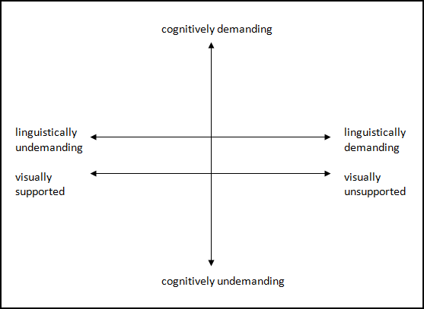
Language demands in CLIL assessment

Slide 12
Reducing the difficulty of questions
Shorter/less complex question
Visual question
Numerical question

Slide 13
Reducing the difficulty of texts
Diagram labelling
Matching

Slide 14
Reduce the difficulty of responding: short-answer formats
Multiple choice
True/false
Gap-filling

Slide 15
Reduce the difficulty of responding: non-linguistic formats
Visual
Numerical

Slide 16
Bandscales
Use a pre-existing scale
Avoid the problems of exact assessment
But is more subjective
should be used with co-assessors, requires inter-rater reliability
Need to be trialled

Slide 17
Profiling
Permits teacher to observe development over time
Allows the assessment of a variety of tasks
Needs a set of performance descriptors
Avoid the problems of exact grading, but should be used with co-assessors

Slide 18
Portfolio assessment
Permits teacher to observe development over time
Allows the assessment of a variety of tasks
Can include a variety of assessment tools
Encourages reflective and self-directed learning
Needs a set of performance descriptors
Avoid the problems of exact grading, but should be used with co-assessors

Slide 19
L1-medium assessment
It may work, but:
Learners may be unable to express knowledge satisfactorily in L1
L1-medium assessment may contradict the principle of L2-medium teaching

Slide 20
Conclusions
Objectives:
Assessment makes CLIL teachers clarify their objectives and methodology
Standards:
Subject standards in CLIL must be equal to or better than in L1-medium teaching
CLIL programmes must have reliable subject performance data
Research:
We don’t know for sure whether CLIL increases subject or language levels
We need data, especially reliable assessment outcomes
Learners:
Learner language levels influence our choice of assessment methods
Techniques:
We need practical knowledge about how to assess in CLIL

